Slide 1
How To:
Submit Online Forms:
Funding Request Form

Slide 2
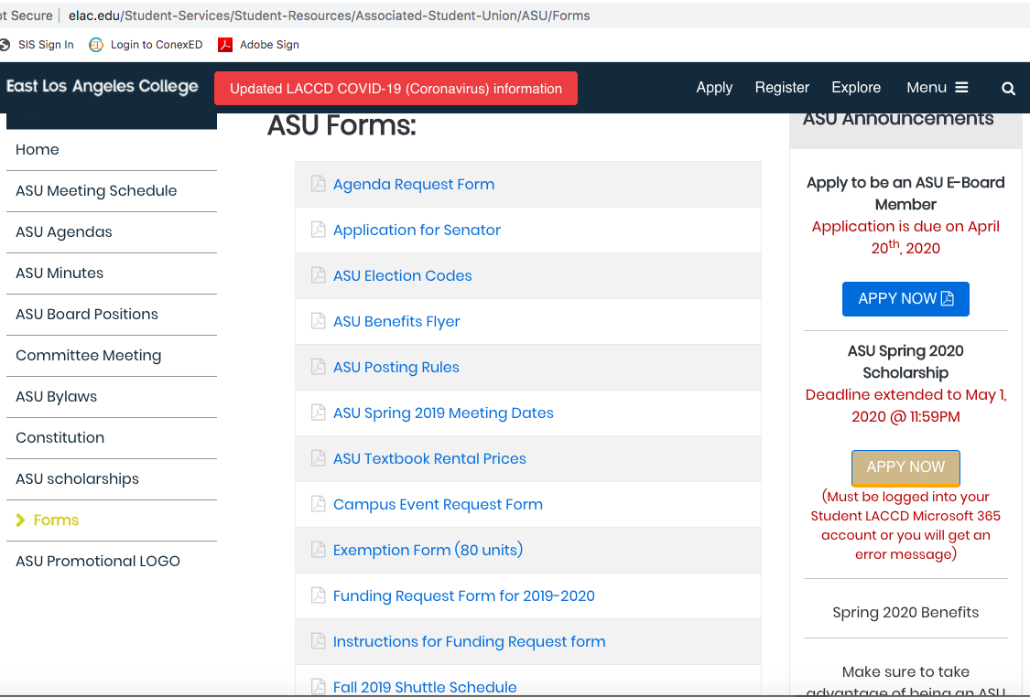
Search: http://elac.edu/Student-Services/Student-Resources/Associated-Student-Union/ASU/Forms

Slide 3
1.) Download the Desired Form. Ex: Funding Request Form

Slide 4
Next, we will set up our Adobe Accounts. Search https://creativecloud.adobe.com/
Create an Account
Use your LACCD Student or Staff/ Faculty Email Account

Slide 5
Once signed-in: Click on the Web Apps and Services Tab: On the Top Right Corner.

Slide 6
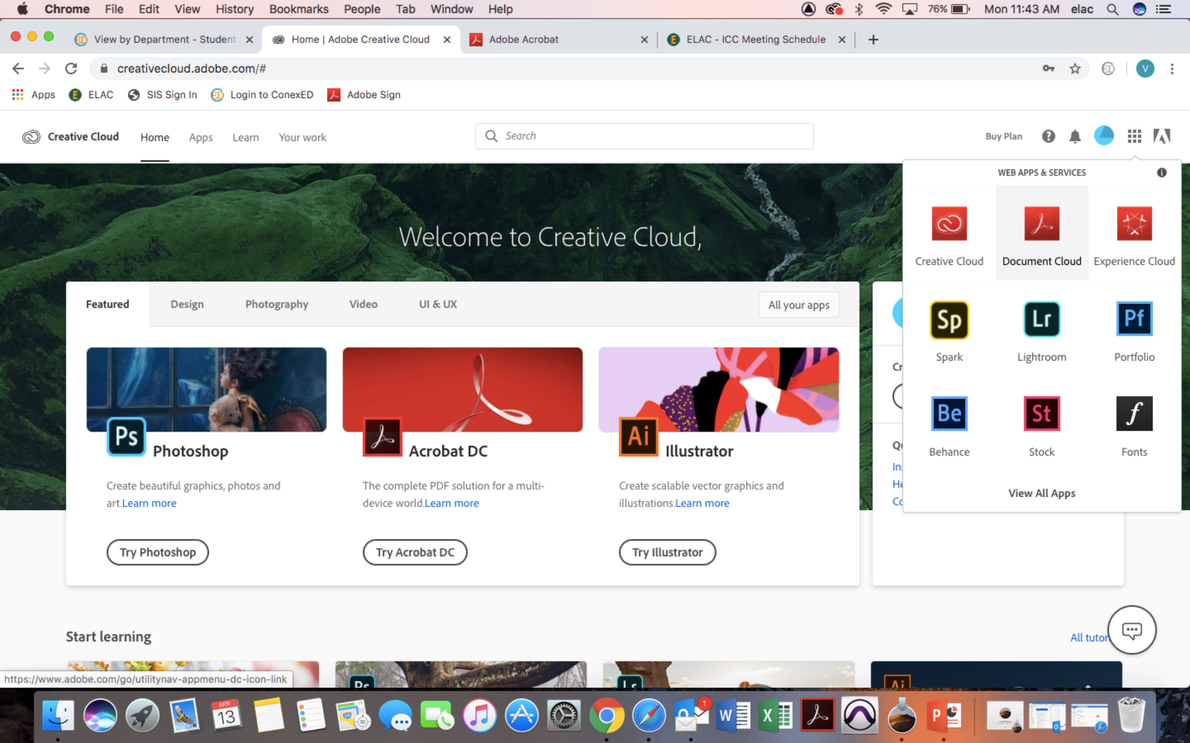
Followed by Document Cloud.

Slide 7
Once Directed to the Page Below: Click on the Edit Option.

Slide 8
If a Signature is Required: Click on the Sign Option

Slide 9
Add Text/ Fill and Sign:

Slide 10
Send to ELAC-ASU-ICC@elac.edu -Attach Funding Request Form (Complete with required signatures) -Attach supporting documentation, such as quotes/ invoices/ receipts.

